Slide 1

E-commerce site
Presented by Admond Tamang
Batch 21

Slide 2
Introduction
E-commerce refers to the sale of goods or products through online Stores.
The main purpose of e-commerce site is that any person can buy as well as sell products.

Slide 3
Problem statement
Not supportive to local market
Miss-conception regarding local product.

Slide 4
Background of the pRoject
To make people believe that local market are rising
To facilitates local products to users.
Build a website that allow user to buy and sell products.

Slide 5
Aims and objectives
Help user find the specific products.
Improve productivity and competitiveness
Encourage local markets.
To reduce cost.

Slide 6
Features
Shopping cart
Multi User Authentication
Checkout system
Searching product
Browse through store/ shop

Slide 7
Work Breakdown structure
E-commerce
Project Managment
Analysis
Design
Implementation
Testing
Risk Management
WBS
Configuration Management
Proposal Submission
Requirement Analysis
Structural Model
Build Database
Unit Testing
Analysis Specification
Use Case
Architecture
Behavioural Model
UI design
Database Design
Coding
Black box Testing
White box Testing
Integration Testing
Deployment
User Training
Final Report

Slide 8
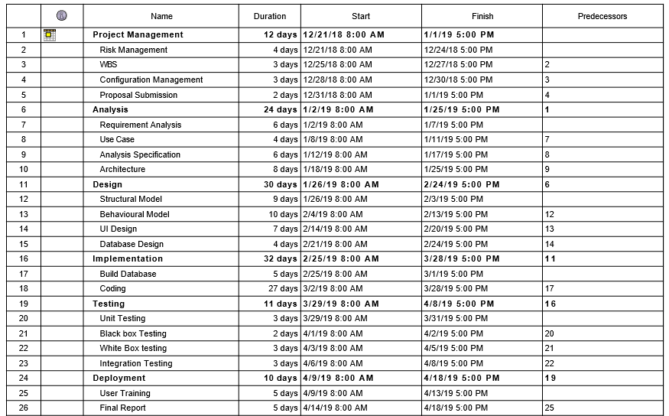
Gantt Chart-1

Slide 9
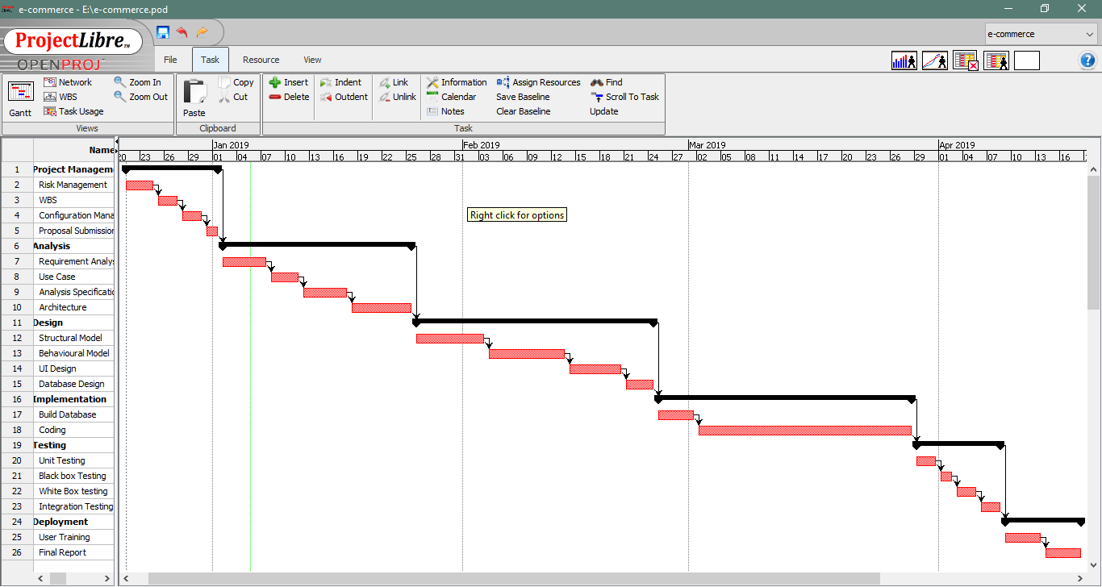
Gantt Chart-2

Slide 10
Waterfall Methodology
Project Management
Analysis
Implementation
Design
Deployment
Testing

Slide 11
Waterfall Methodology
The waterfall methodology was used because of following reasons:
It is simple and easy to understand.
Progress of my project can be tracked easily.
My project has clear requirement, so I think waterfall model is suitable for my project.

Slide 12
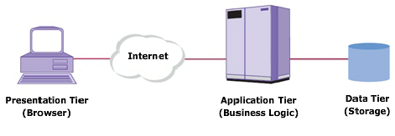
3-tier architecture
Presentation
Application
Data tier

Slide 13
Risk management
Impact = Likelihood * Consequences
S. No | Risks | Likelihood | Consequences | Impact | Solution
 | Lack of staff training | 2 | 3 | 6 | At the stage of deployment, staff should be trained properly to use the system.
 | Data theft | 3 | 4 | 12 | Strong company policy should be established.
 | Failure to meet requirement | 2 | 4 | 12 | Proper planning is to be done in every phase.
 | DDOS attack | 1 | 4 | 4 | Placing the publicly exposed server in DMZ.
 | Database error | 1 | 5 | 5 | Analyze the data traffic and upgrade the hardware if necessary.
 | Server failure | 1 | 5 | 5 | IT security should be hired to look after the server.
 | Change in government policy | 1 | 5 | 5 | Should be aware about the situation of the country and make changes accordingly.

Slide 14
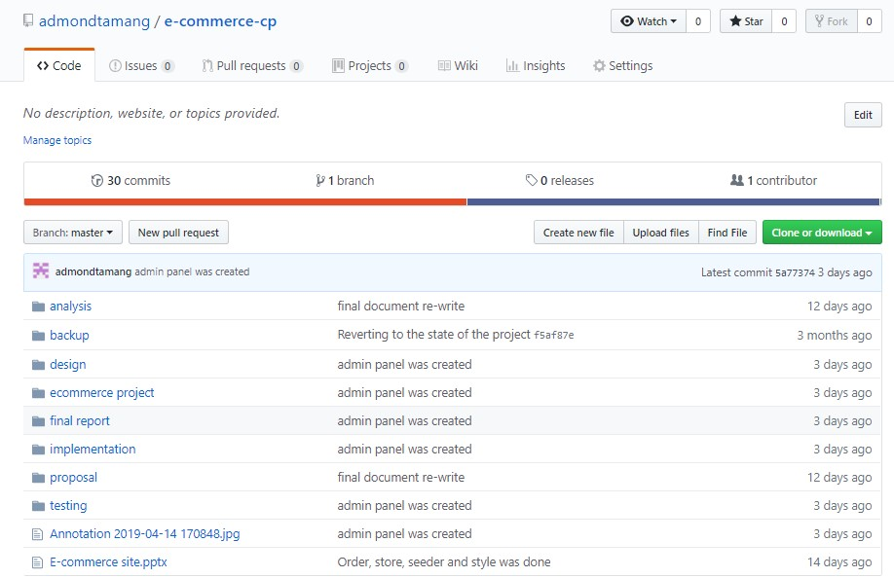
Configuration management
I used github to keep track of my project.

Slide 15
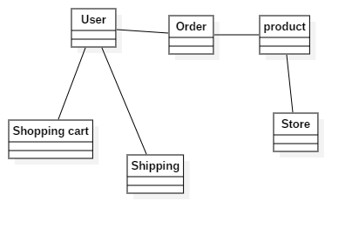
Design: initial Class diagram

Slide 16
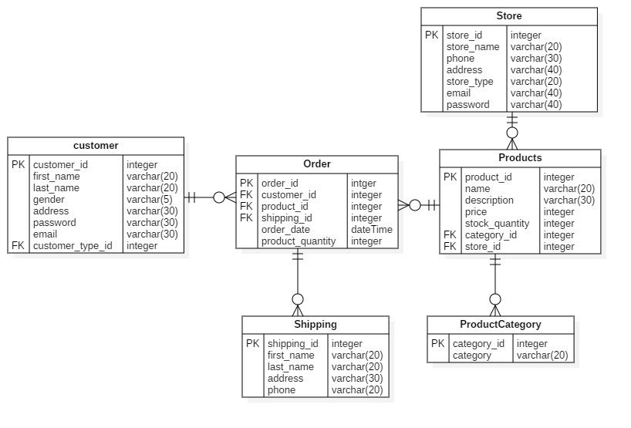
Er-diagram

Slide 17
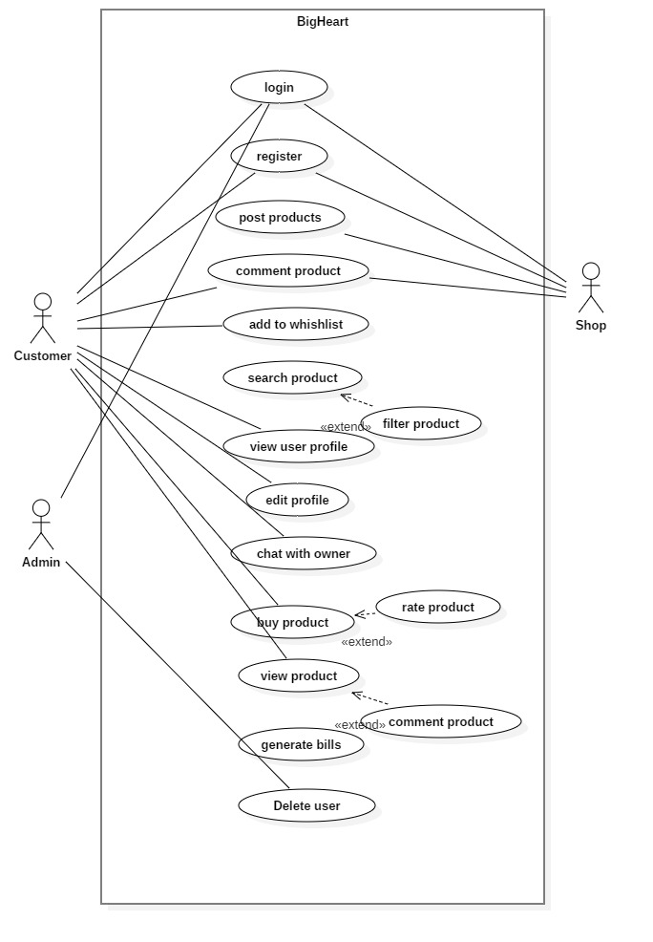
Use Case diagram

Slide 18
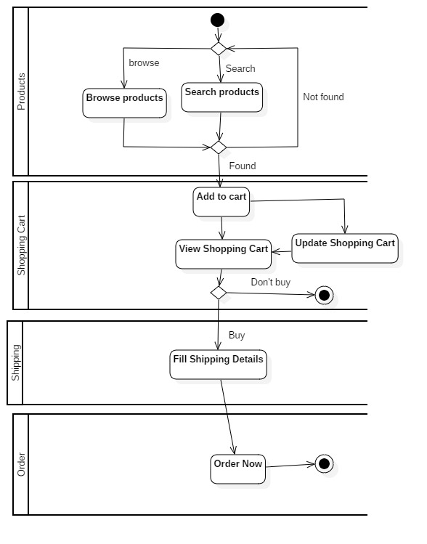
Activity Diagram
It is a type of diagram that represents an algorithm, workflow or process.it is usually represented using connecting lines and set of conventional symbols.
it contains various phase which the progression flow from initial to finsh.it routines for evolving business strategies, significant troubleshoot phase and scheming accurate procedures.

Slide 19
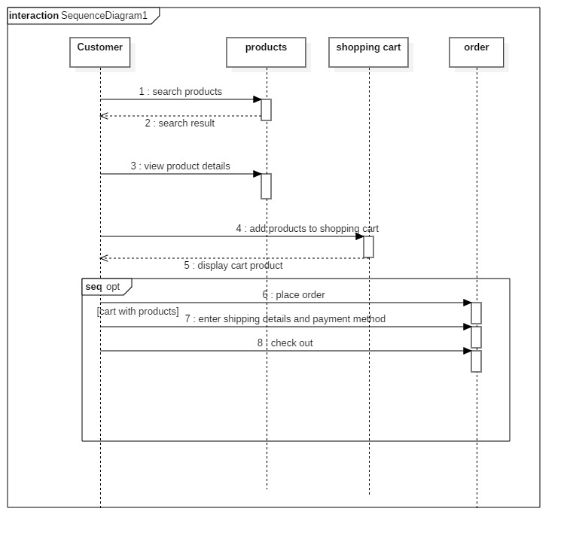
Sequence diagram
It demonstrates object communications organized in time order.it describes in what way and in what direction a collection of objects works composed. It is also known as interaction diagram that shows how one object interact with another object in message format which gets exchange over time. It also comes under behavior model

Slide 20
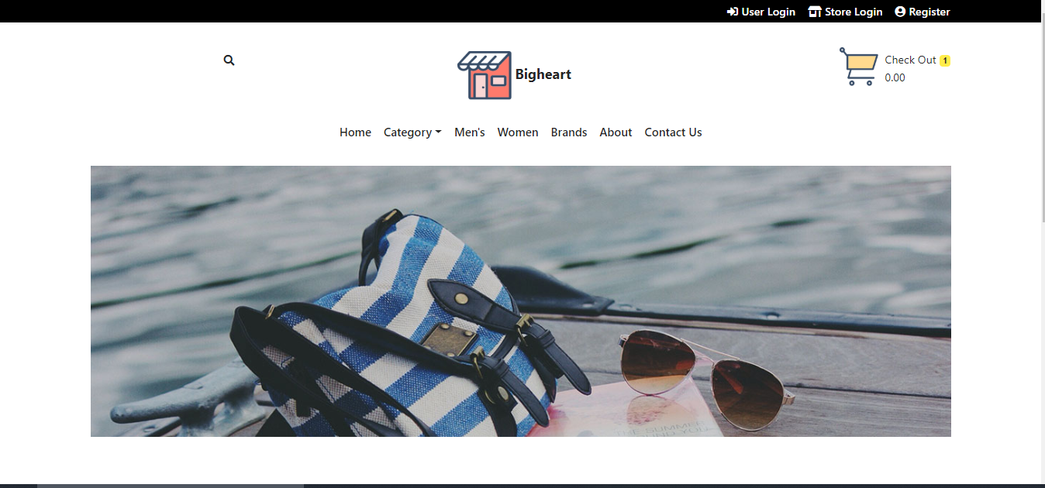
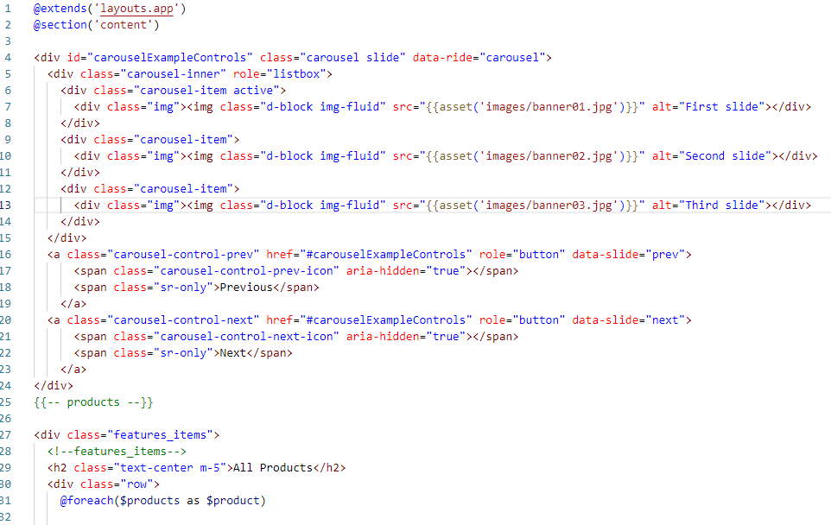
UI design and code

Slide 21
Home page-code

Slide 22
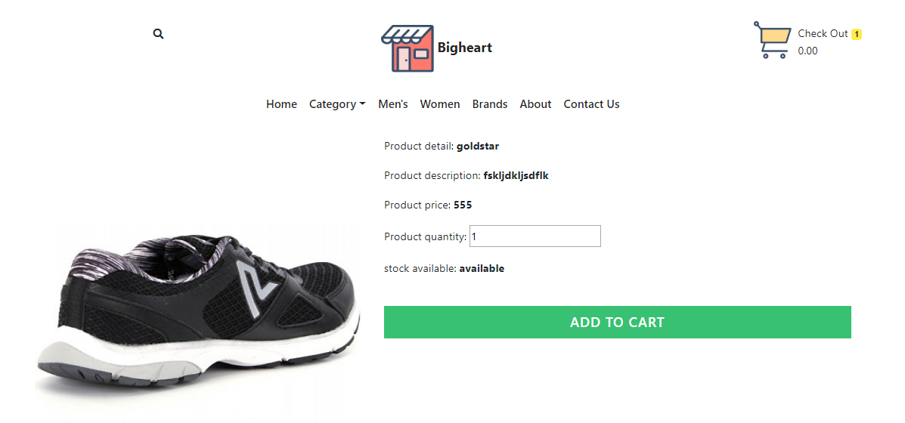
Product detail- design

Slide 23
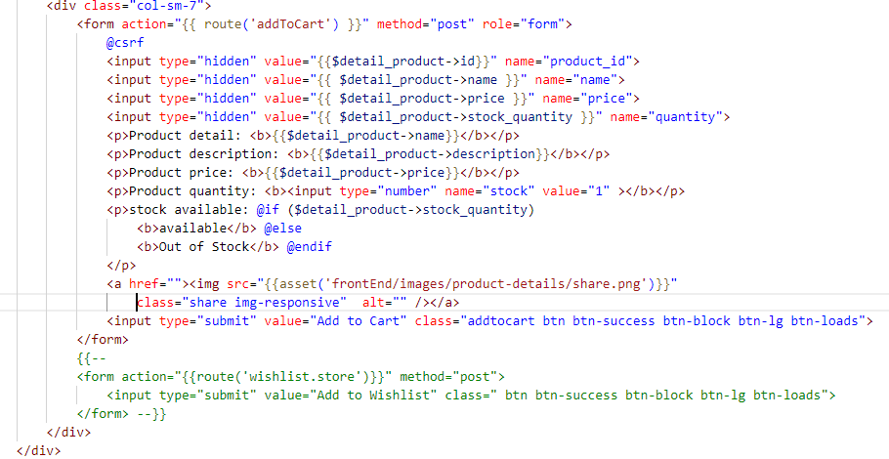
Product detail- code

Slide 24
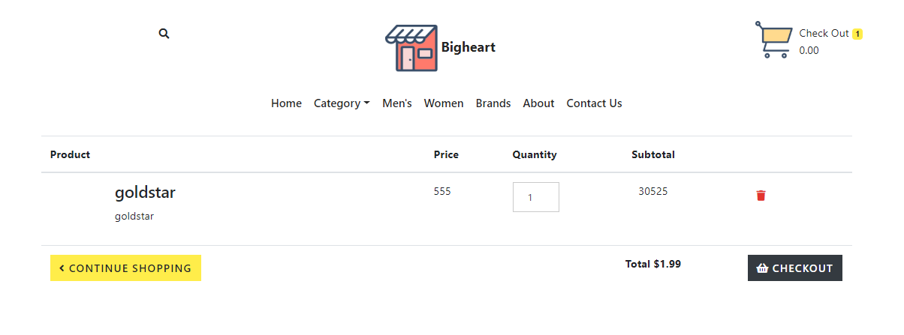
cart Ui

Slide 25
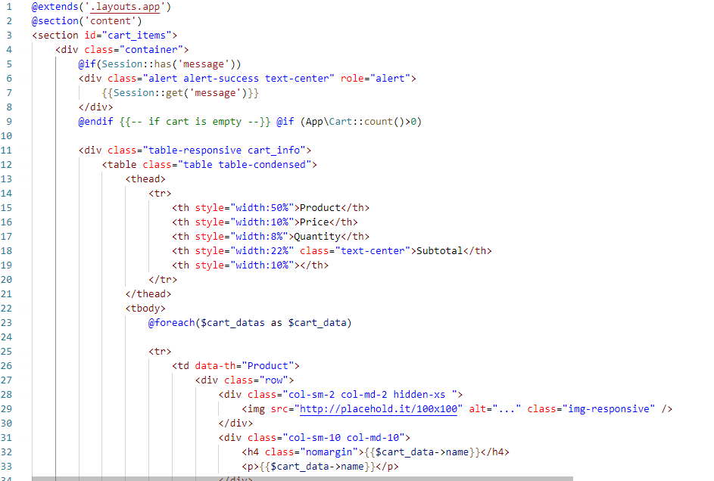
Cart code

Slide 26
Unit Testing
One test for one function.
Each method test one thing only.
Only one assert in one method.
Independent test. No data sharing between test.

Slide 27
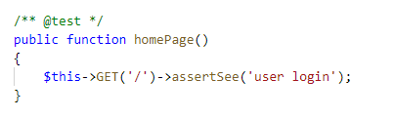
Test case 1
Test case no | 1
Purpose of test | To check route is working
Test data
Expected result | Visit home page
Actual Result | Successfully visited
Class | testLogin

Slide 28
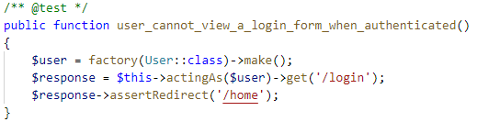
Test case 2
Test case no | 2
Purpose of test | To check user can login without authentication
Test data
Expected result | Redirect to login
Actual Result | Redirected to login
Class | testLogin, UserFactory

Slide 29
Future work
Make payment system
User can sign up with social media like facebook, google etc
GUI modification for more interactive experience.
Real time chat system
Use of validation

Slide 30
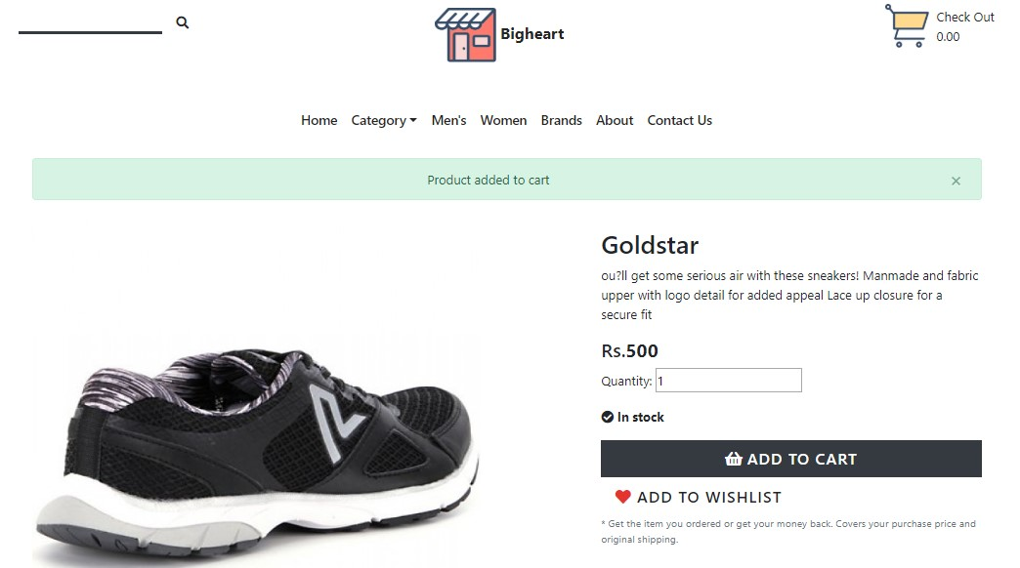
User manual
Select products you like
Click on add to cart button

Slide 31
User manual-2
Now, click on (check out) at the top right corner where you'll find the products you want to buy.
Make changes if you don't want to buy

Slide 32
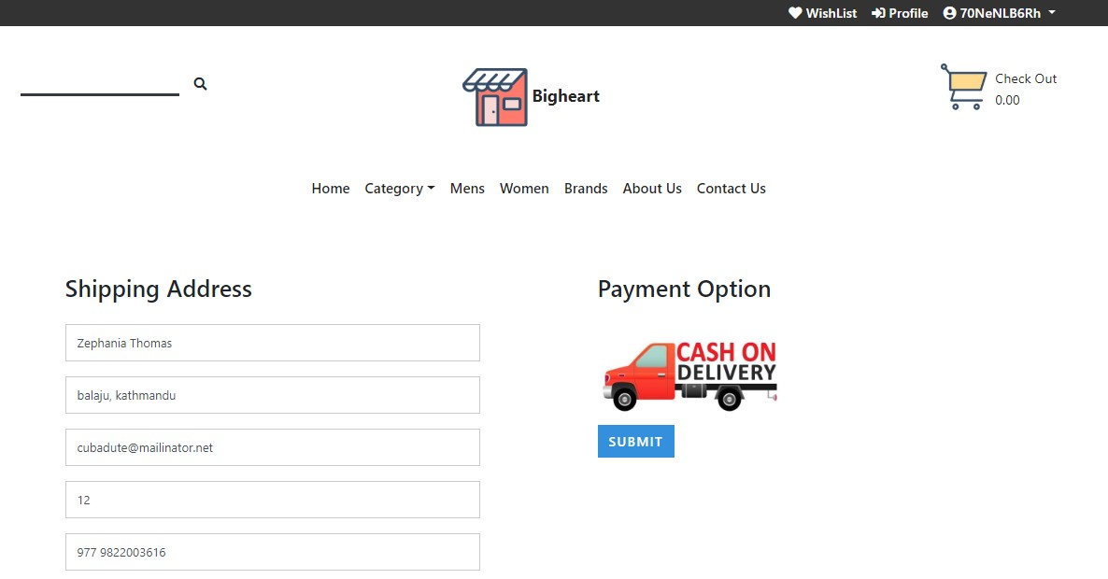
User manual-3
Click on checkout to go to order product.
Fill up shipping address and payment method.
Now, click order to conform all purchase item.
Hurray, you've successful order a product from the website.

Slide 33
LIMITATION
Delivery manages
Track products
Money protection
Payment system
Needs strong Validation

Slide 34
Conclusion
By using electronic technology through the internet, it achieved.
More competitions, more marketplaces, faster transactions, and more advanced technologies
To make activities between customers and producers more active.
We as customers and internet users are responsible to keep our e-commerce healthy and safe so that e-business can be more reliable in the future

Slide 35
references
admin, S., 2012. softwaretestingclass. [Online] Available at: https://www.softwaretestingclass.com/what-is-black-box-testing/ [Accessed 8 4 2019].
Anon., 2019. businessdictionary. [Online] Available at: http://www.businessdictionary.com/definition/object-oriented-analysis.html [Accessed 8 4 2019].
Anon., n.d. [Online] Available at: https://www.visual-paradigm.com/guide/uml-unified-modeling-language/what-is-class-diagram/

